Slide 1
TD Summer Reading Club 2023
Join the Club!

Slide 2
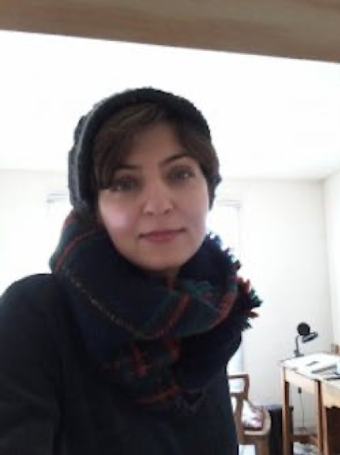
Nahid Kazemi
Meet the 2023 Artist
Nahid is the author and illustrator of Shahrzad & the Angry King. She won the Governor General’s Award for illustrating The Sour Cherry Tree by Nasim Hrab.
Her artwork is featured on the TDSRC notebooks, stickers and website.
Nahid lives in Montreal, Ontario.
Notes:
This year’s TD SRC artist is Nahid Kazemi
Nahid is the author and illustrator of Shahrzad & the Angry King. She won the Governor General’s Award for illustrating The Sour Cherry Tree by Nasim Hrab.
Her artwork is featured on the TDSRC notebooks, stickers and website
Nahid lives in Montreal, Ontario

Slide 3
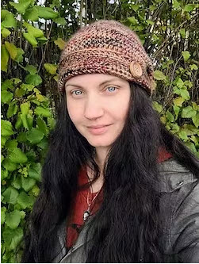
Cyndi Marko
Meet the 2023 Web Comic
Cyndi an author and illustrator, some of her books include: Sloth Sleuth, Boo Hiss!, and the Kung Pow Chicken series.
Cyndi lives in Penticton, British Columbia.
Her web comic, The Hooman Show, will be live on our website on June 12, 2023.
Notes:
Author and illustrator Cyndi Marko has written an original three panel web comic for our website titled The Hooman Show.
You can read the comic and then participate in discussion questions with other kids at the bottom of each of the three panels.
There is also a separate and original web comic in French by Julien Castanié that kids can check out as well, called À qui la chance?

Slide 4
Notebooks
For kids ages 0—5
For kids ages 6—12

Slide 5
Web access code
Notes:
With your logbook you will also get a web access sticker. This sticker has a secret code that allows you to access free English & French ebooks available on the TDSRC kids website.
Your logbook has a special spot for the code here….
[Advance Slide]
Web Access code sticker moves to designated spot on image of logbook.

Slide 6
Notebook Stickers
Notes:
You can participate in the Club at your local library.
You can earn a sticker for when you tell staff about the books you read/listen to throughout the summer.
You can report in different ways (verbal, written, drawn) between June 13-September 3.
Book reporting takes place [tell kids when they can visit your branch for book reporting].
Each age group will also get a set of stickers. Here are the stickers for the school-age notebook
[Note for staff: 2022 TDSRC Stickers will arrive in July]

Slide 7
Kids’ Site
tdsummerreadingclub.ca
Highlights:
eBooks
Web comic
Book recommendations
Online notebook
Battle of the books
Author and illustrator videos
Jokes
Silly stories
Story starters
Colouring pages
Trivia questions
Launches June 12, 2023

Slide 8
Jokes

Slide 9
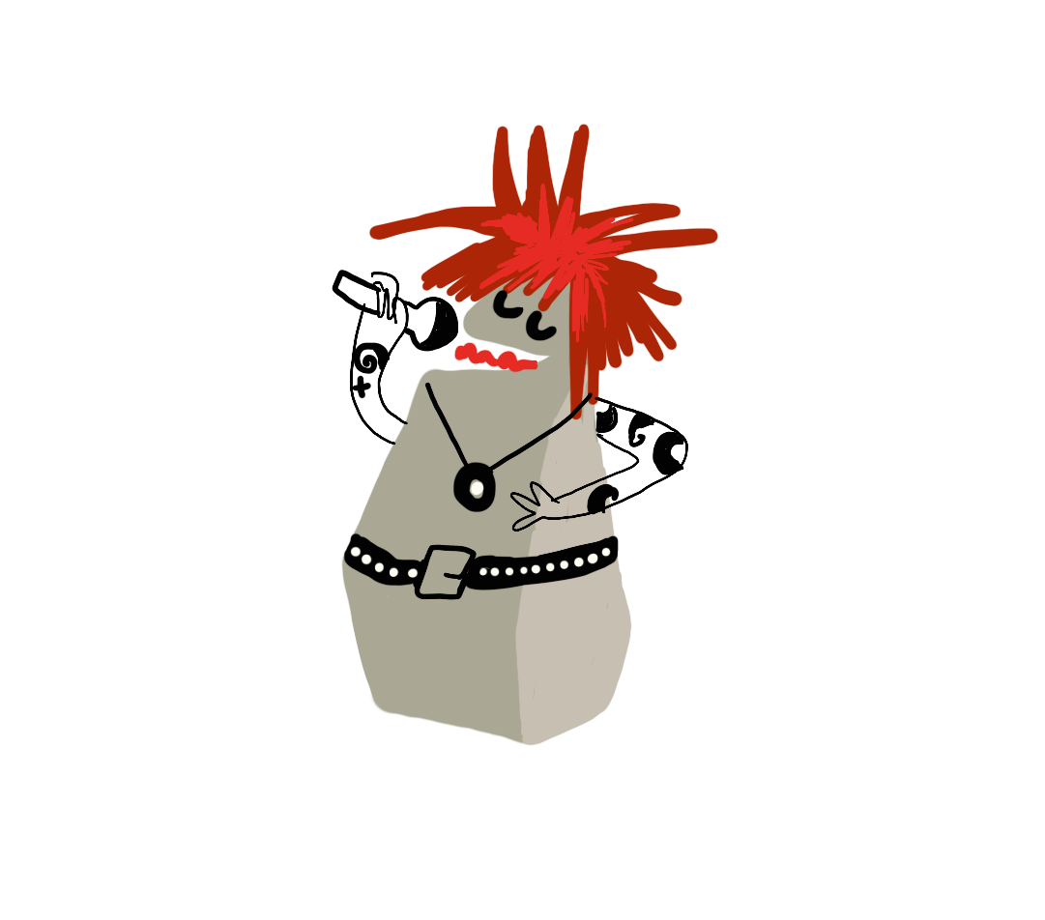
What type of music do balloons hate?
Pop Music
Notes:
Read joke, then advance slide for answer

Slide 10
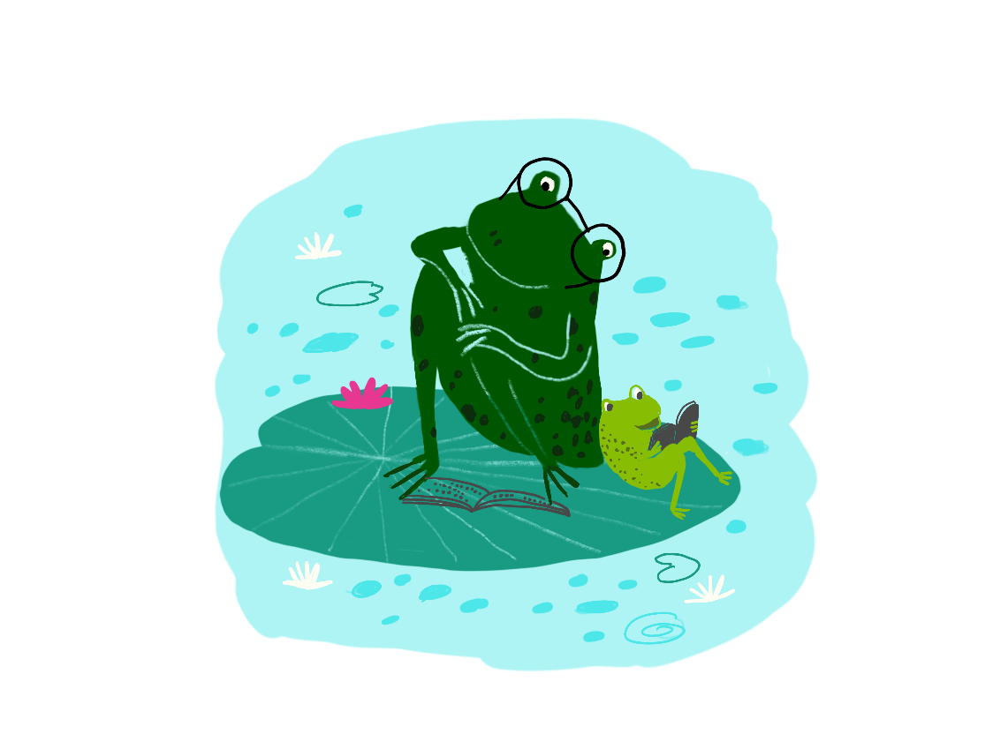
Why are frogs so happy?
They eat whatever BUGS them
Notes:
Read joke, then advance slide for answer

Slide 11
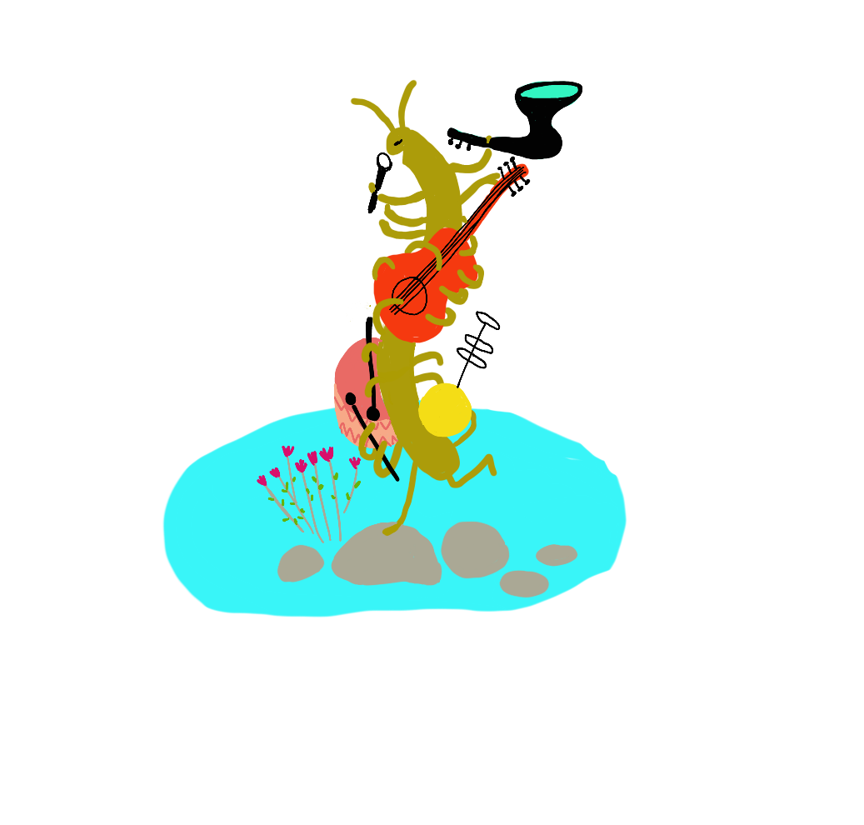
What do you call a musical insect?
A humbug
Notes:
Read joke, then advance slide for answer

Slide 12
Battle of the books
Choose your
favourite Canadian book and help it win the tournament
Vote on a new battle each week
Each book can be read on our website as an eBook!
Notes:
This slide to be updated

Slide 13
Trivia questions
Sir Arthur Conan Doyle was an author who created one of the most famous detectives of all time. What was the name of this detective?
a) Sherrington Holmes
b) Sherrinford Holmes
c) Sherlock Holmes
d) Geronimo Stilton
Correct answer!
Look for a new trivia question every week on our website!

Slide 14
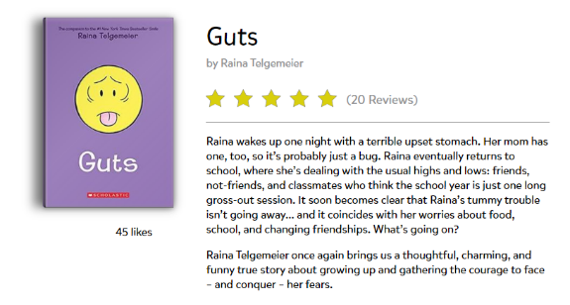
Read and review books
Read awesome books
for free, all summer!
Review books
Notes:
You can post reviews on books you’ve read and read reviews from other kids across Canada.

Slide 15
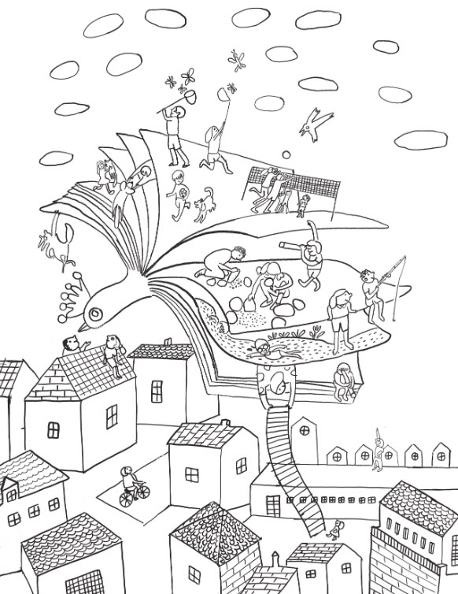
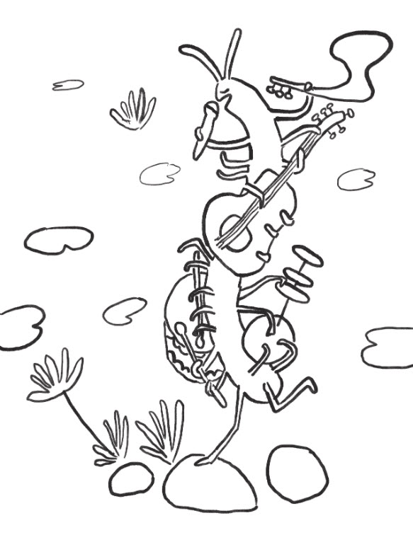
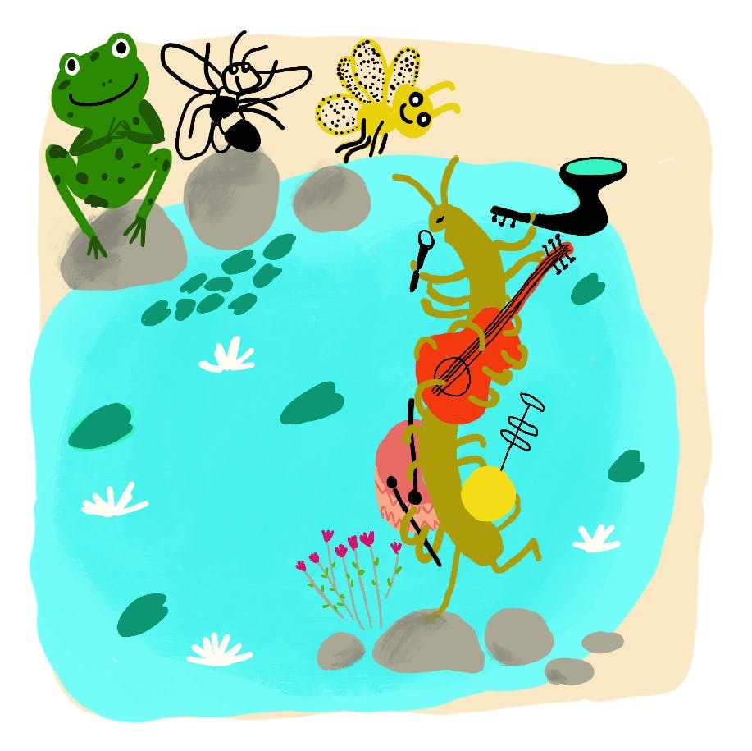
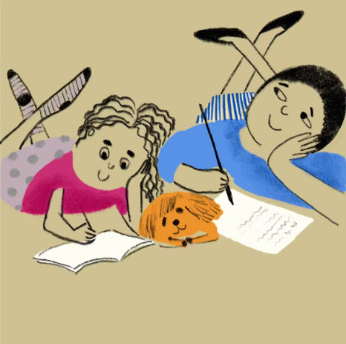
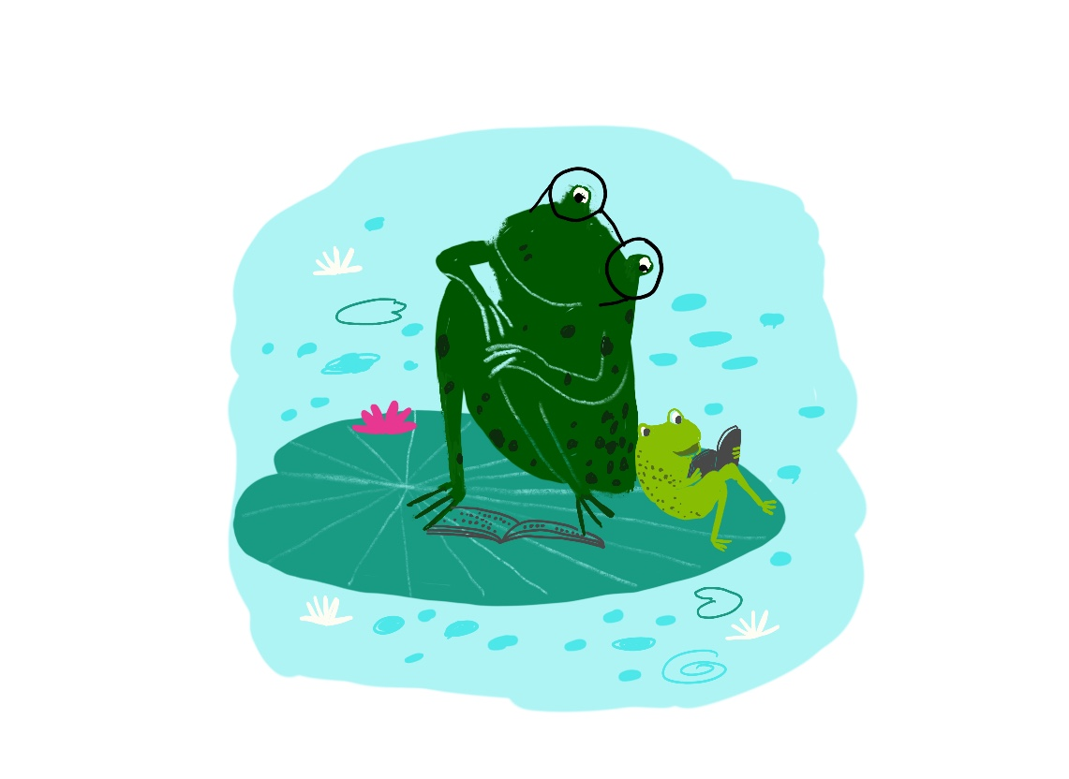
Other fun stuff online
Print colouring sheets
Write your own story
Keep track of your reading in your online notebook
Silly stories
Story starters
Notes:
You can also find story starters, colouring pages and more!

Slide 16
Click here to enter program name
Insert a picture here by clicking on the icon below and then browsing and selecting the desired image. Crop the image to fit, if needed.
Enter program date here…
Enter program description here…

Slide 17
Click here to enter program name
Insert a picture here by clicking on the icon below and then browsing and selecting the desired image. Crop the image to fit, if needed.
Enter program date here…
Enter program description here…

Slide 18
Click here to enter program name
Insert a picture here by clicking on the icon below and then browsing and selecting the desired image. Crop the image to fit, if needed.
Enter program date here…
Enter program description here…

