Slide 1
Aliens Have Landed! Trivia

Slide 2
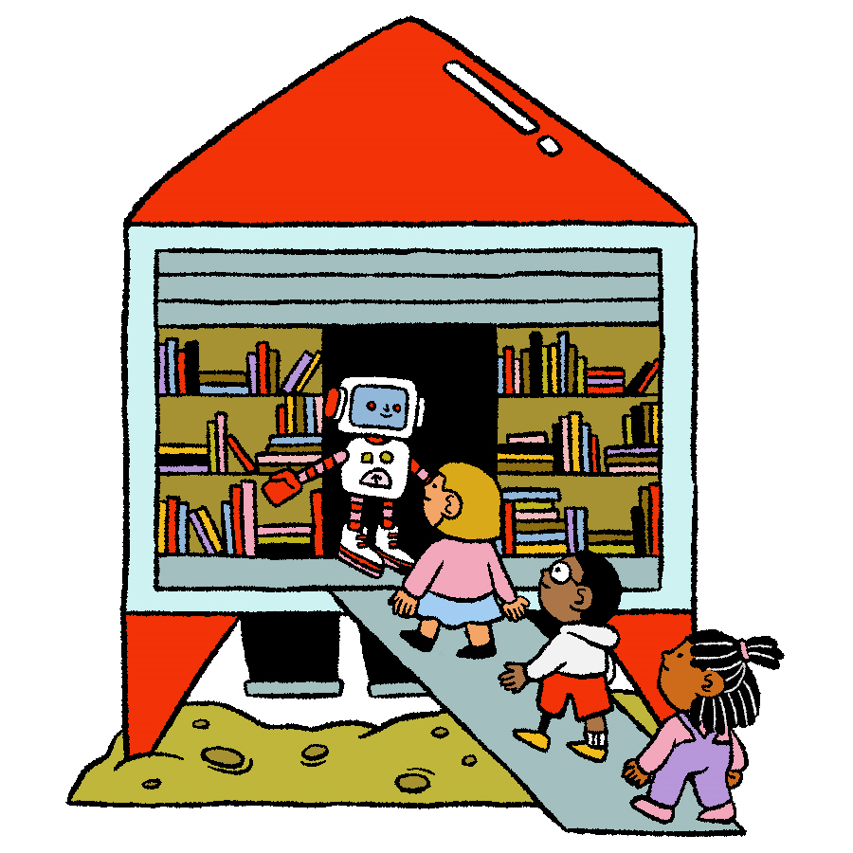
Rules to Outsmart the Aliens
Three correct letters must be called before someone can guess the secret word.
For each incorrect letter, a part of the alien will appear.
Guess the word before the alien fully lands on the screen!
NEXT

Slide 3
What colour is the sunset on Mars?
B
L
U
E
A
B
C
D
E
F
G
H
I
J
K
L
M
N
O
P
Q
R
S
T
U
V
W
X
Y
Z
NEXT
Notes:
Unused letters: A, C, D, F, G, H, I, J, K, M, N, O, P, Q, R, S, T, V, W, X, Y, Z

Slide 4
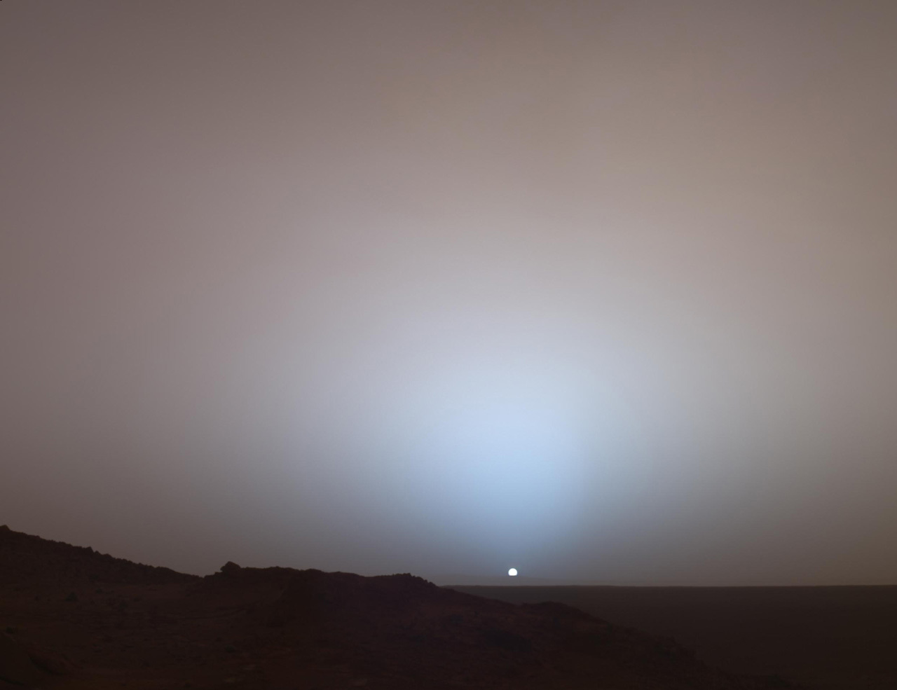
Sunsets for Martians are blue.
At sunset, there’s less sunlight on Mars. Only the stronger, bluer parts of the Sun’s light can pass through, which turns the sky from red to blue.
NEXT

Slide 5
What do you call a star explosion?
S
U
P
E
R
N
O
V
A
A
B
C
D
E
F
G
H
I
J
K
L
M
N
O
P
Q
R
S
T
U
V
W
X
Y
Z
NEXT
Notes:
Unused letters: B, C, D, F, G, H, I, J, K, L, M, N, P, Q, T, W, X, Y, Z

Slide 6
A supernova is the colossal explosion of a star.
Scientists have discovered
several different types.
NEXT

Slide 7
On Neptune, it rains ______?
D
I
A
M
O
N
D
S
A
B
C
D
E
F
G
H
I
J
K
L
M
N
O
P
Q
R
S
T
U
V
W
X
Y
Z
NEXT
Notes:
Unused letters: B, C, E, F, G, H, J, K, L, P, Q, R, T, U, V, W, X, Y, Z

Slide 8
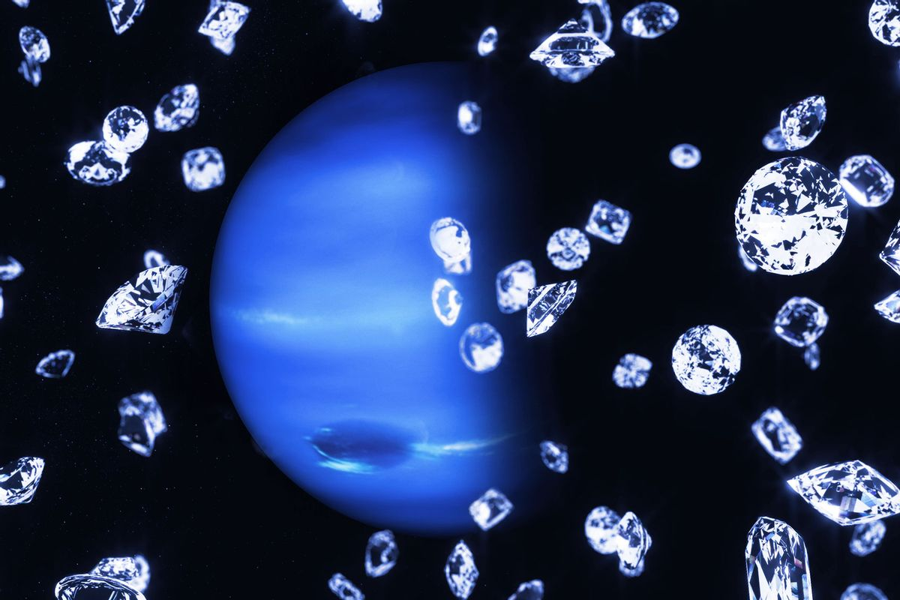
Scientists have created the conditions of Neptune in their lab and arrived at this strong hypothesis for diamond rain.
It may also rain diamonds on the icy planet of Uranus!
NEXT

Slide 9
What galaxy are we in?
T
H
E
A
B
C
D
E
F
G
H
I
J
M
I
L
K
Y
K
L
M
N
O
W
A
Y
P
Q
R
S
T
U
V
W
X
Y
Z
NEXT
Notes:
Unused letters: B, C, D, F, G, J, N, O, P, Q, R, S, U, V, X, Z

Slide 10
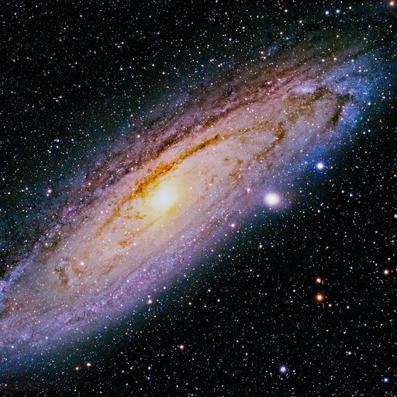
Galaxies are groups of stars, gas, and dust, all bound together by gravity.
Our solar system is part of the Milky Way, just one of billions of galaxies in the Universe.
NEXT

Slide 11
What was Chris Hadfield’s first job?
T
E
S
T
P
I
L
O
T
A
B
C
D
E
F
G
H
I
J
K
L
M
N
O
P
Q
R
S
T
U
V
W
X
Y
Z
NEXT
Notes:
Unused letters: A, B, C, D, F, G, H, J, K, M, N, Q, R, U, V, W, X, Y, Z

Slide 12
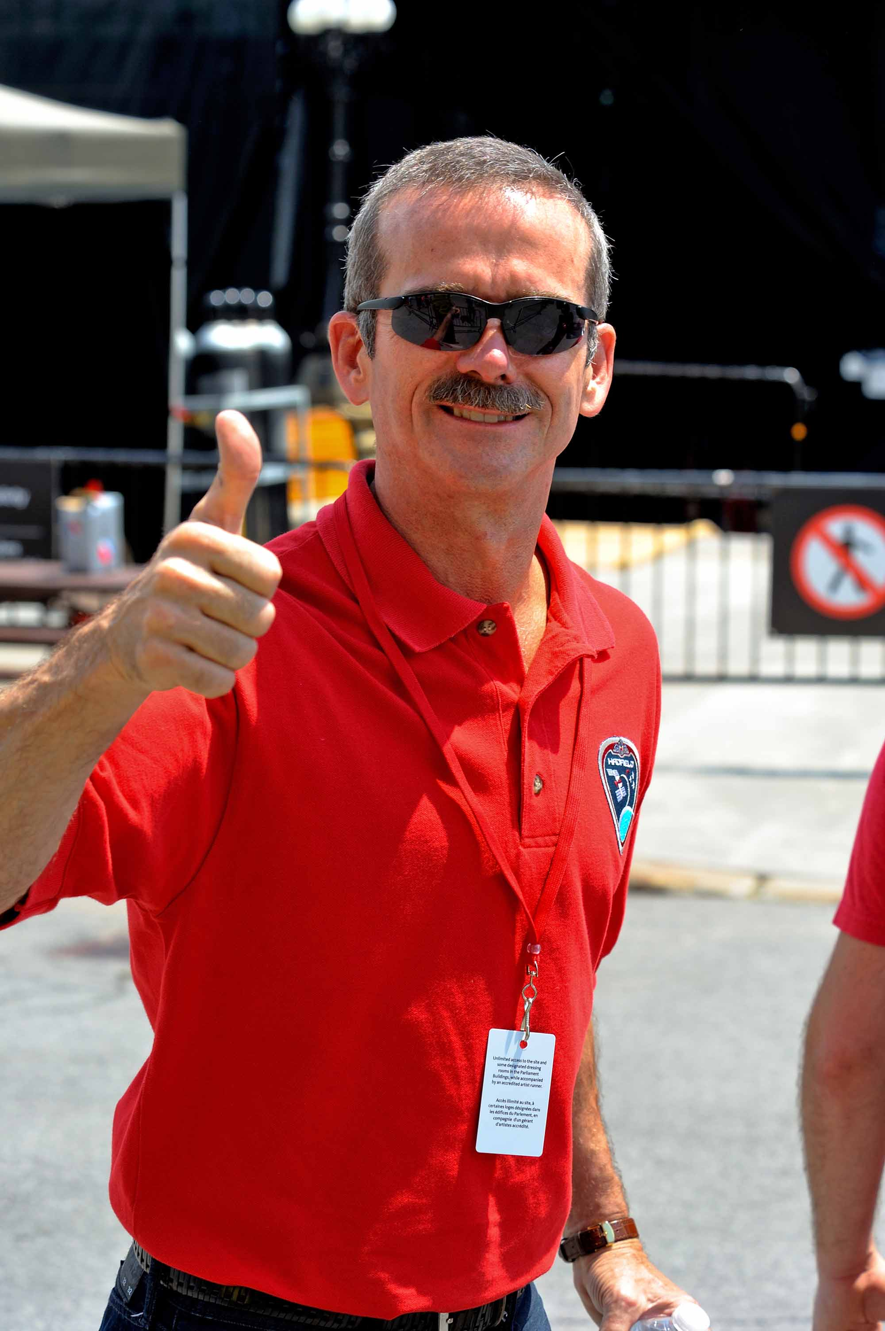
Canadian astronaut, Chris Hadfield, began his career as a test pilot.
He flew over 70 different types of aircraft!
NEXT

Slide 13
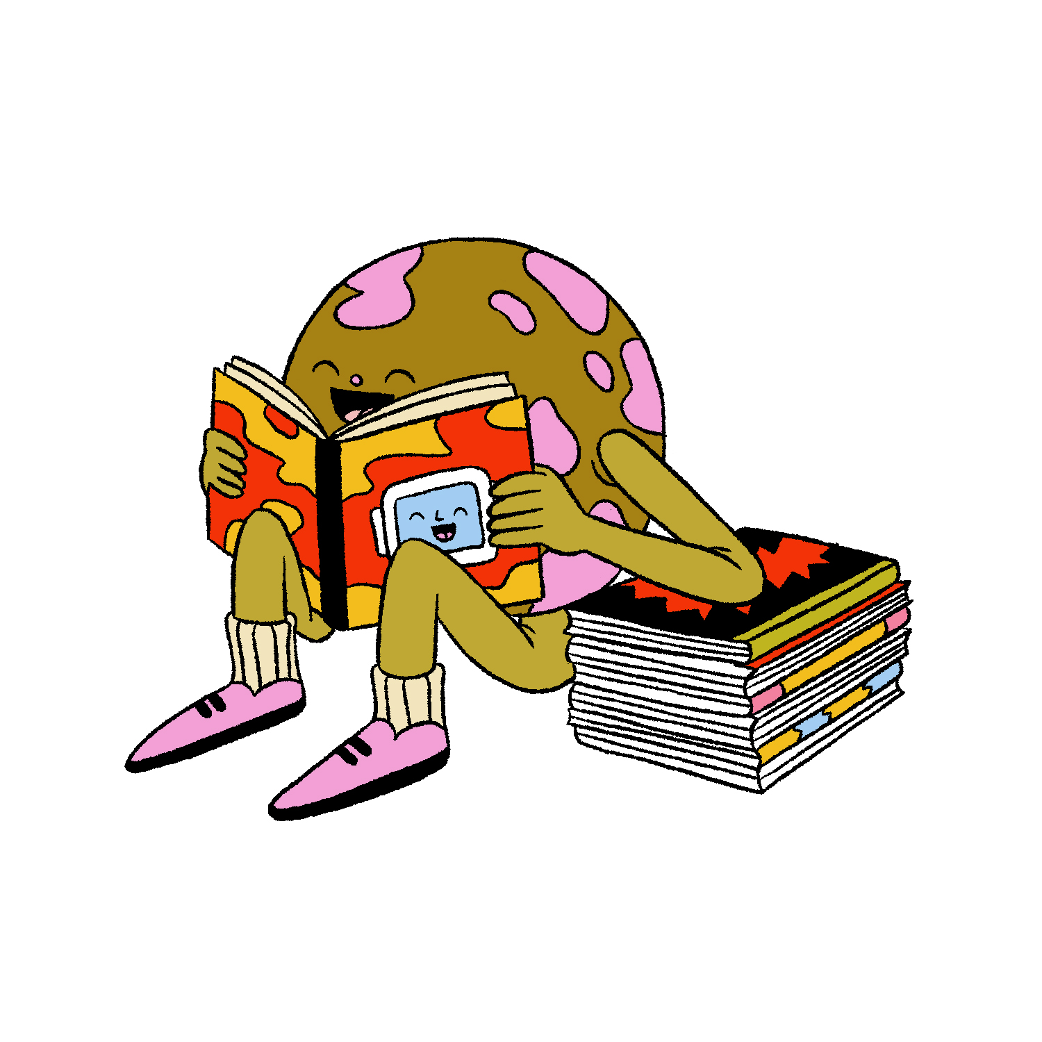
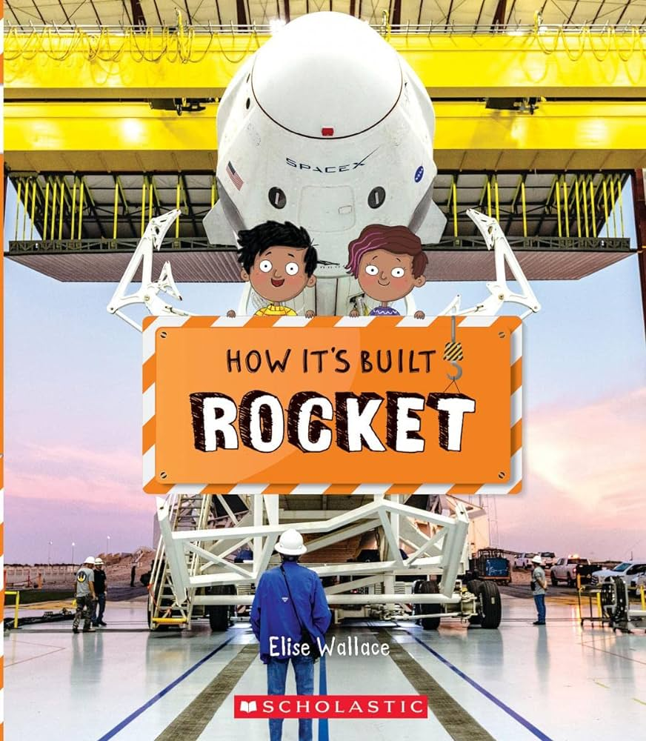
Want even more space fun?
Join this year’s TD Summer Reading Club and check out our recommended reads.
NEXT

Slide 14
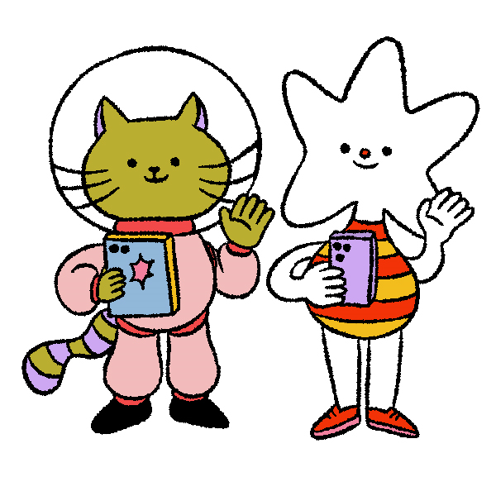
Register for your free kit, then join us online! www.tdsummerreadingclub.ca

