Slide 1
TD Summer Reading Club 2020
Join the Club!

Slide 2
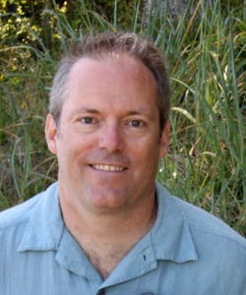
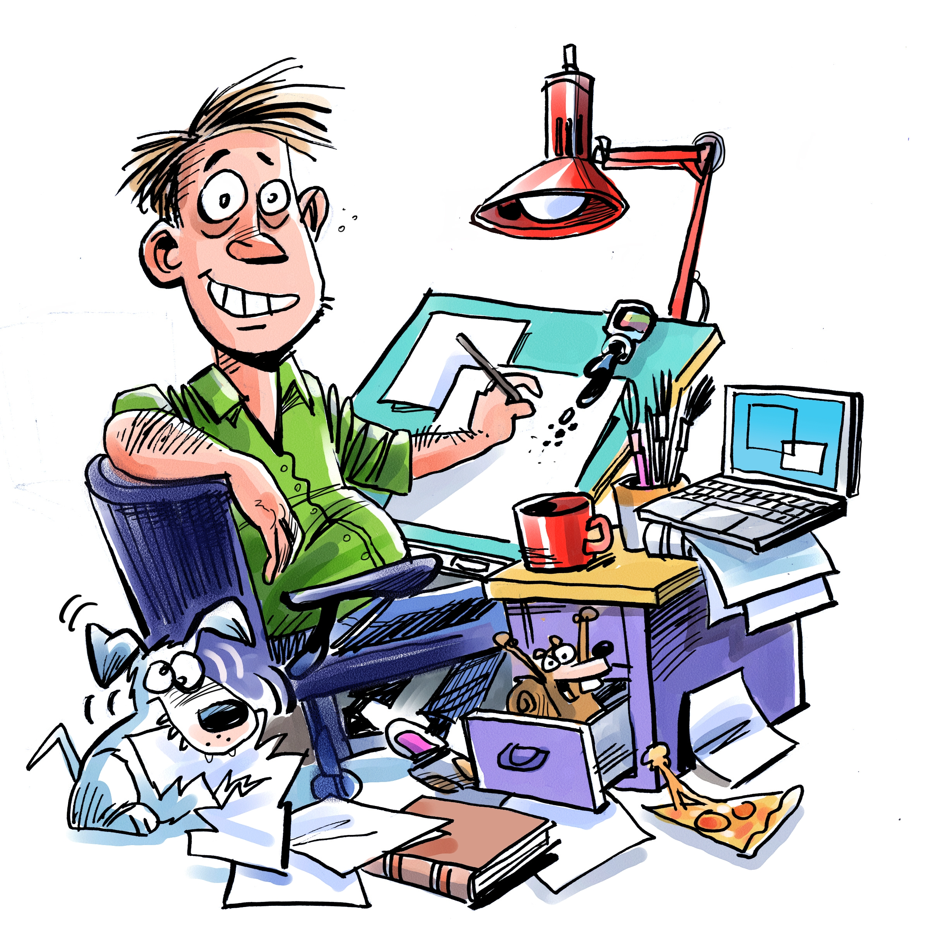
Dave Whamond
Dave in real life
2020 Artist
About Dave Whamond
Dave has worked on more than 30 books, including Rosie’s Glasses, My Think-a-ma-Jink, the Oddrey series, Frank and Laverne, Nick the Sidekick, and a Robert Munsch book, Braids
His artwork is featured on our notebooks, stickers and website
Dave lives in Calgary

Slide 3
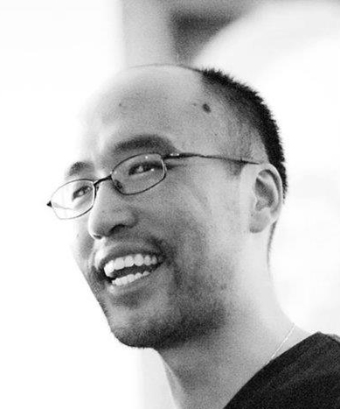
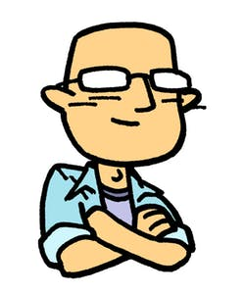
Kean Soo
Kean in real life
2020 Online Web Comic
About Kean Soo
Author and illustrator of the award-winning graphic novel series Jellaby, and the book March Grand Prix: The Fast and the Furriest
His new web comic, The Transfer Student, will be live on our website on June 15, 2020
Kean lives in Toronto

Slide 4
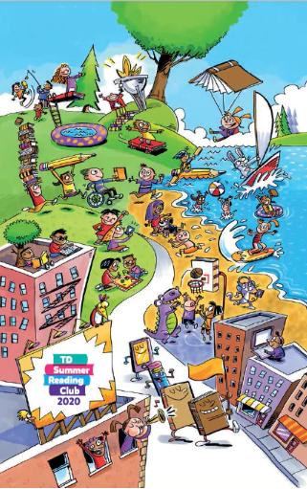
Notebooks
For kids ages 0—5
For kids ages 6—12

Slide 5
Web access code

Slide 6
Stickers

Slide 7
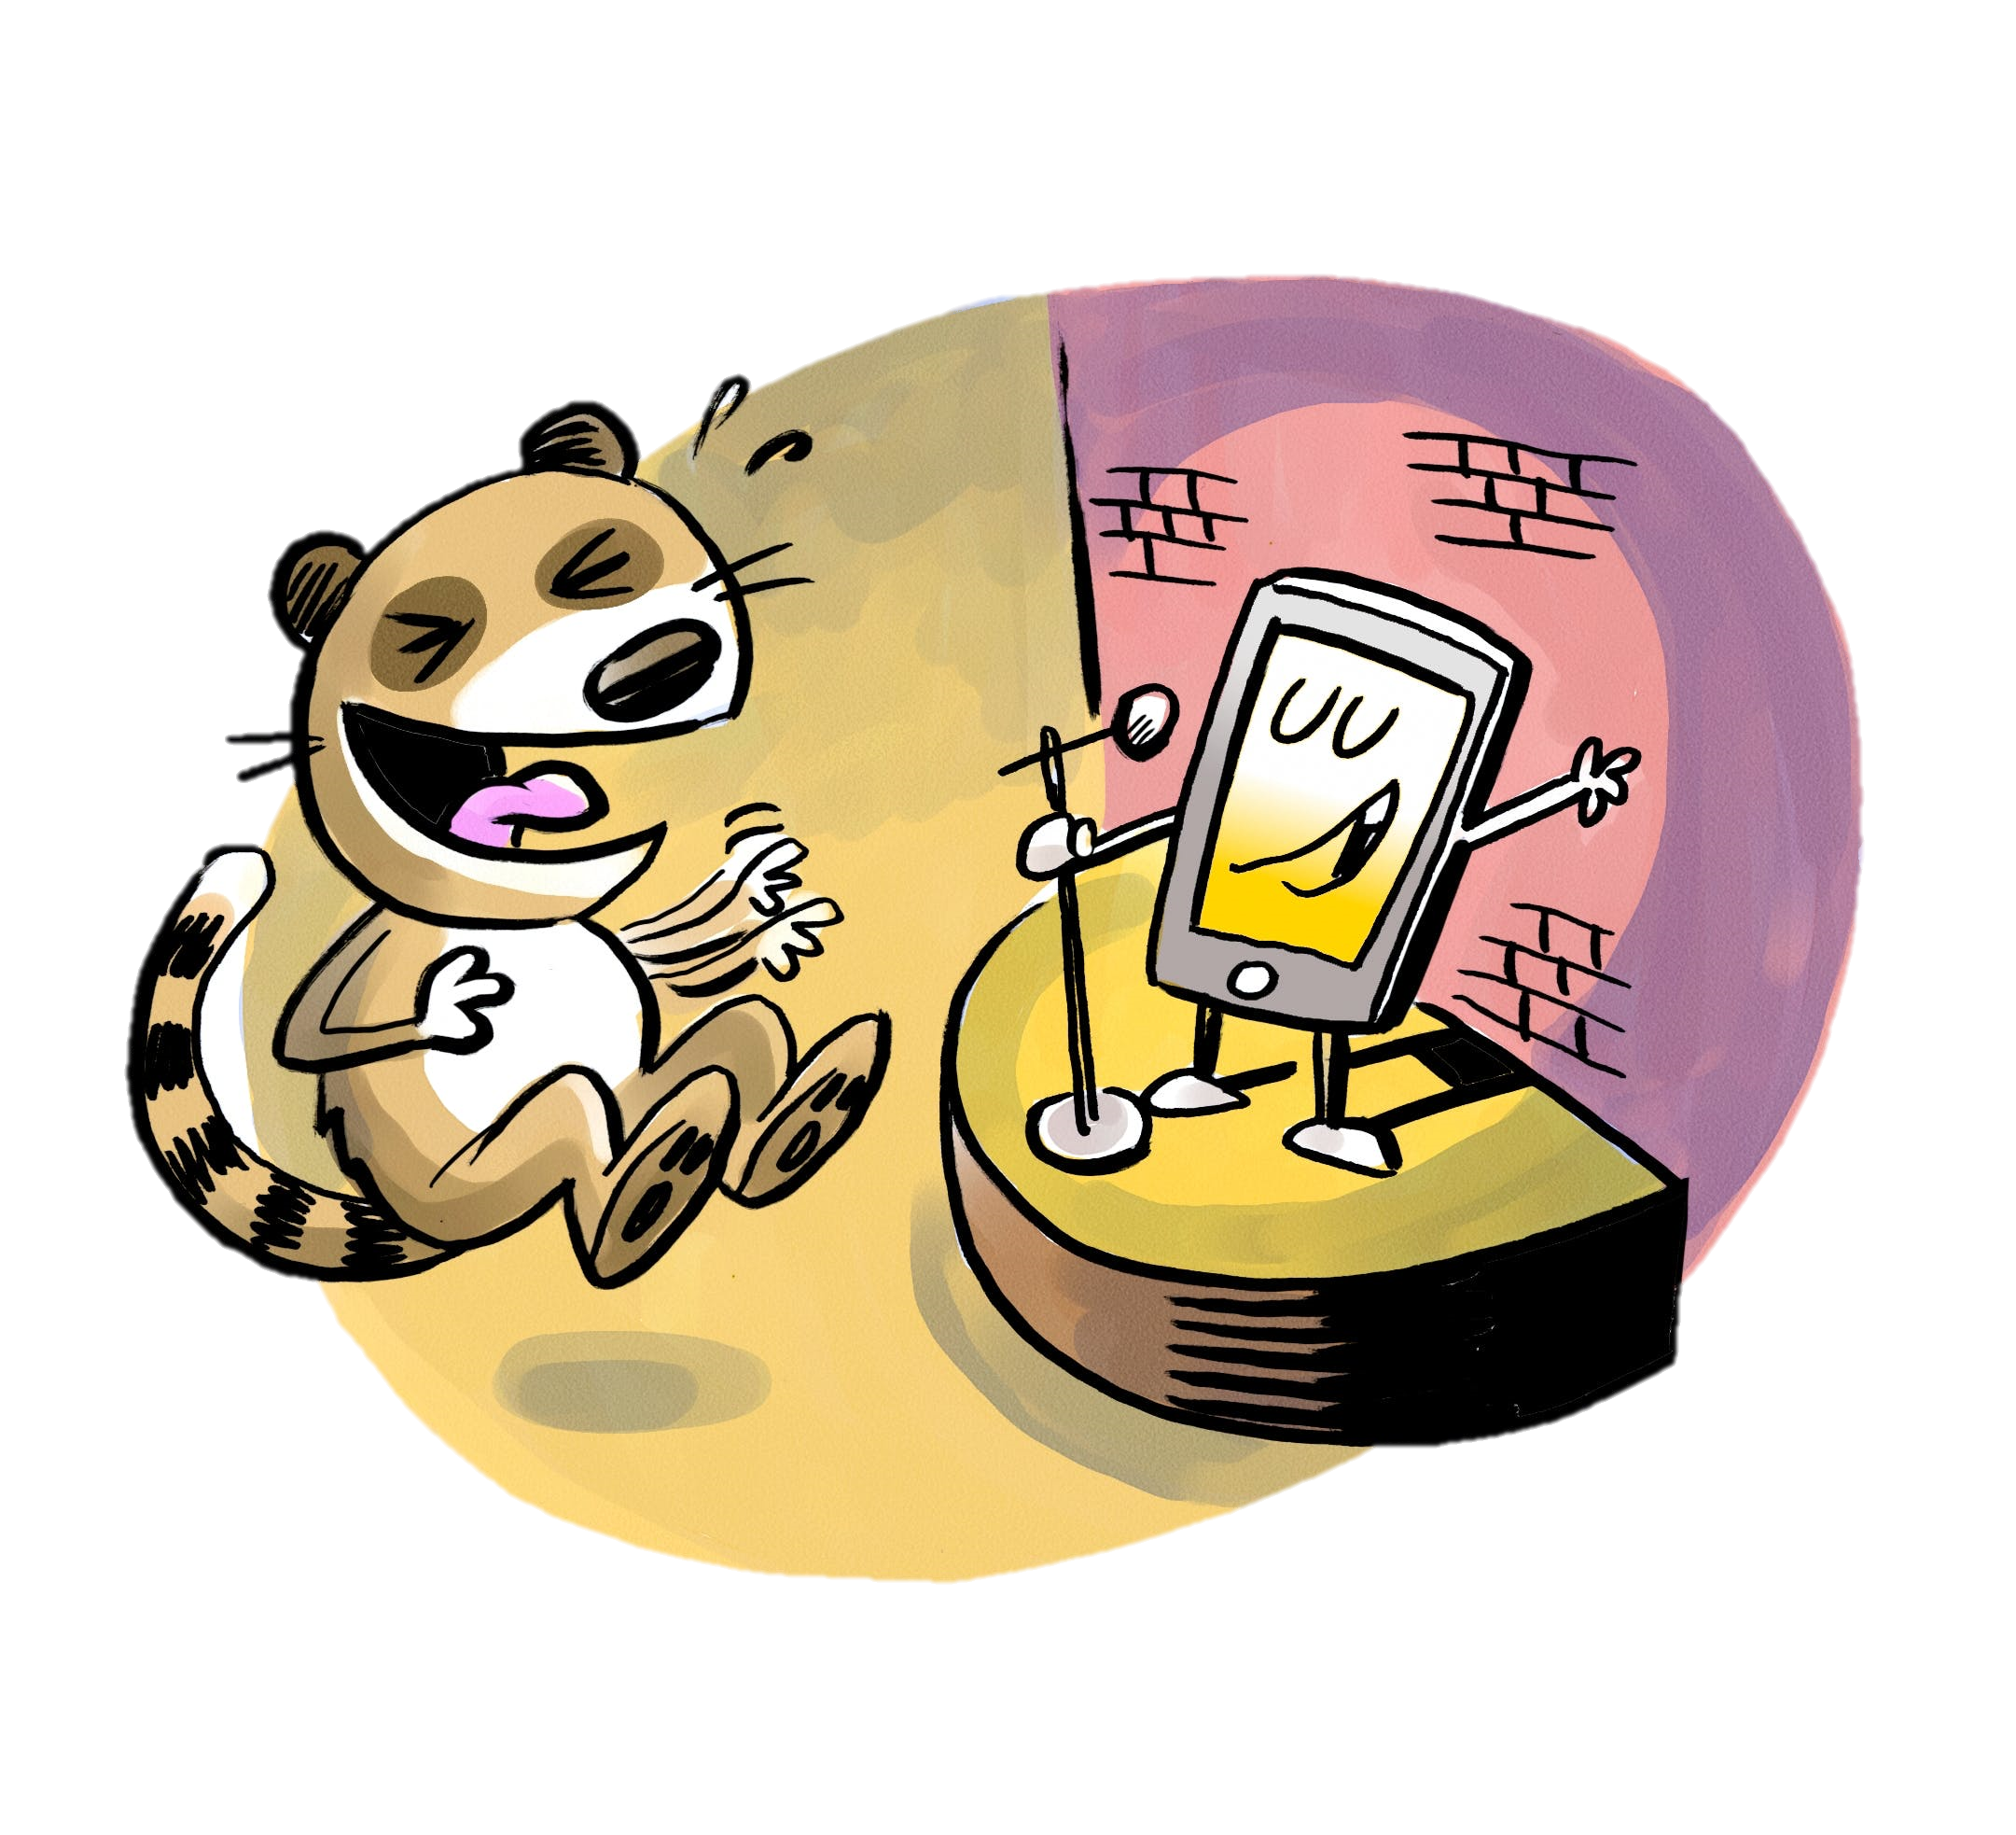
Kids website
tdsummerreadingclub.ca
Highlights:
Jokes
Silly stories
Story starters
Colouring pages
Trivia questions
ebooks
Book recommendations
Web comic
Online notebook
Battle of the books (New!)
Launches June 15, 2020

Slide 8
Jokes

Slide 9
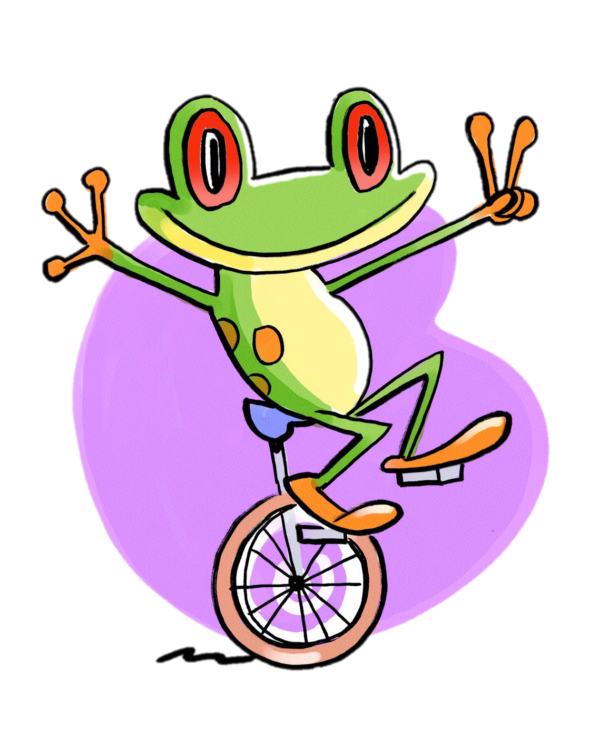
What happens when frogs park illegally?
They get toad

Slide 10
What do you call an alligator in a vest?
An Investi-Gator

Slide 11
How do you make an octopus laugh?
With ten-tickles

Slide 12
How does Darth Vader likes his toast?
On the dark side

Slide 13
What did the dog say after a long day of work?
Today was ruff

Slide 14
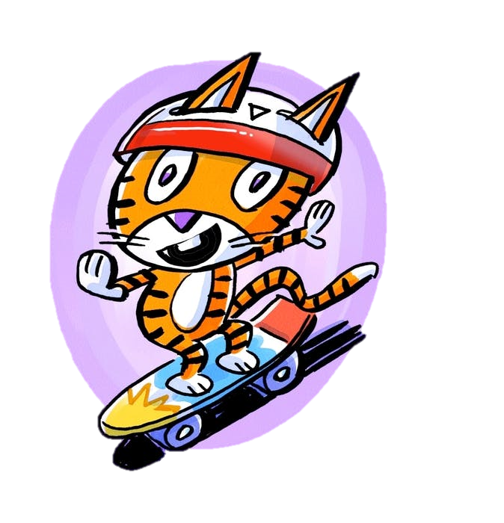
Why was the cat happy?
Because he had a PURR-fect day

Slide 15
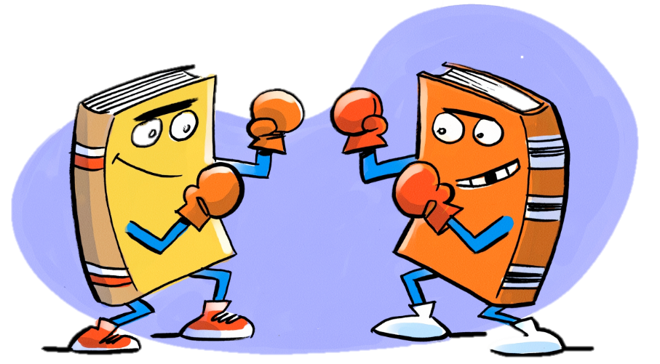
Battle of the books
Choose your favourite book and help it win the tournament
Vote on a new battle each week
Each book can be read on our website as an ebook!

Slide 16
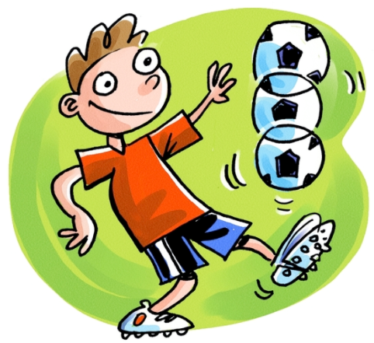
Trivia questions
What is the world record for juggling a soccer ball with just your feet, legs, shoulders and head?
a) 35 minutes
b) 6 hours
c) 19 hours
d) 26 hours
Correct answer!
Look for a new trivia question every week on our website!

Slide 17
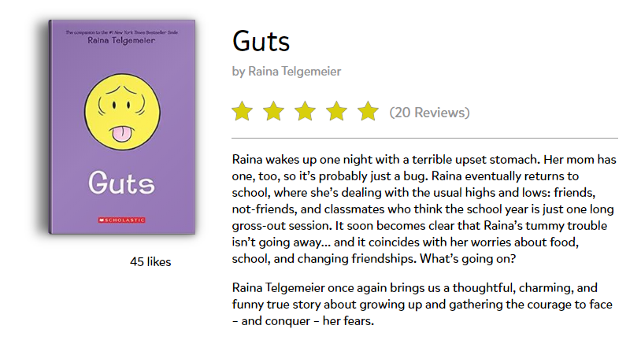
Read and review books
Read awesome books online
(for free, all summer)
Review books

Slide 18
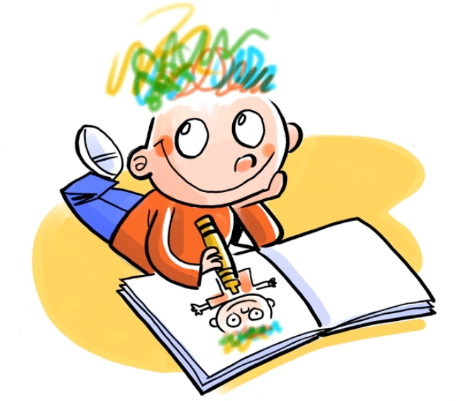
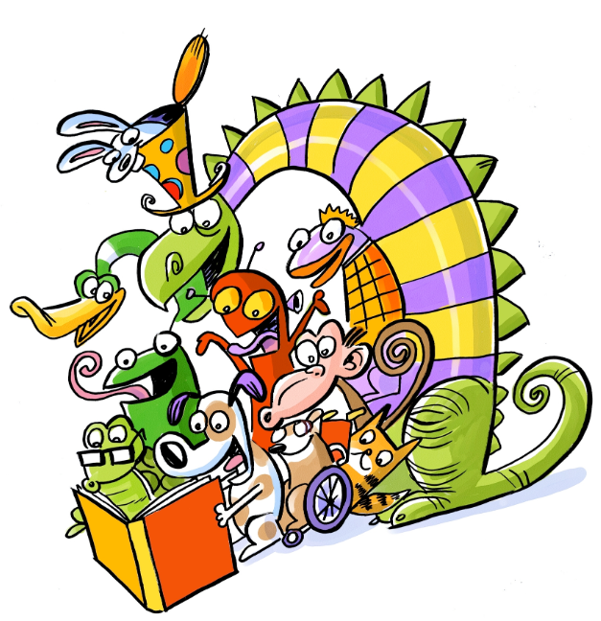
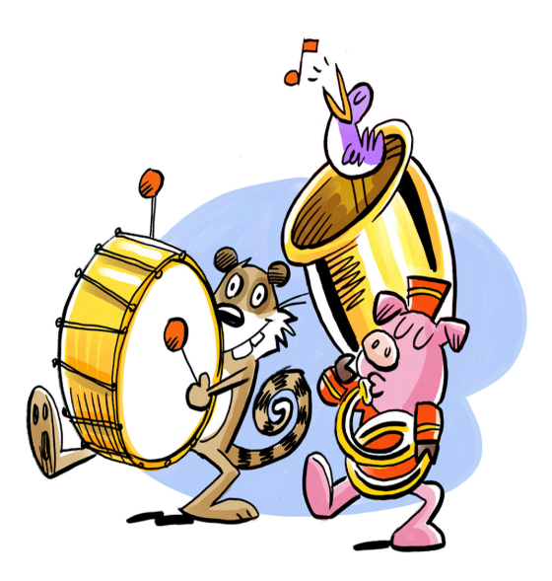
Other fun stuff online
Print colouring sheets
Write your own story
Keep track of your reading in our online notebook
Silly stories
Story starters

Slide 19
Click here to enter program name
Insert a picture here by clicking on the icon below and then browsing and selecting the desired image. Crop the image to fit, if needed.
Enter program date here…
Enter program description here…

Slide 20
Click here to enter program name
Insert a picture here by clicking on the icon below and then browsing and selecting the desired image. Crop the image to fit, if needed.
Enter program date here…
Enter program description here…

Slide 21
Click here to enter program name
Insert a picture here by clicking on the icon below and then browsing and selecting the desired image. Crop the image to fit, if needed.
Enter program date here…
Enter program description here…

