Slide 1

Trapped in the Library
TD Summer Reading Club Escape Game
Notes:
Staff:
Click on the Slide Show tab and click From Beginning.
You may want to ask students to have a pencil and paper available for the riddles

Slide 2



It’s late on a summer evening, and you’re walking back home from soccer practice.
Suddenly, the sky turns grey, and it starts to rain. You shuffle into an alleyway to escape the rain. You see an ominous-looking building with the sign Library.
“That’s strange,” you think to yourself. “I didn’t know there was a library here.”
You pull on the door handle, enter the library, and allow the door to close behind you.
Click. The door locks.

Slide 3
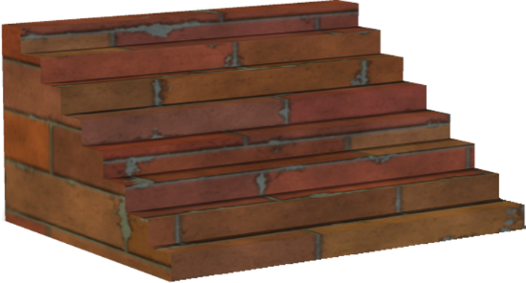
The library is dark and appears empty.
You take a few nervous steps forward and come to a staircase.
You walk down the stairs and see a long hallway. The first door on your left has the word “Quiet” written on it. You grasp the doorknob and slowly turn it.

Slide 4

You open the door and are shocked to see an owl perched on a pile of books, quietly reading.
“Oh, hello,” the owl exclaims. “Welcome to the overnight library. This area is for quiet reading. You’re welcome to spend the night here reading, if you want. You just need to be really quiet.”

Slide 5


“Uh, no thanks,” you say. “Do you know how I can get out of here? My parents are expecting me home.”
“The only other exit is at the end of this long hallway,” the monster replies. “But no one has been able to figure out the combination on the keypad.”
“Ok, thanks!” you say. You quietly shut the door and walk to the end of the hallway.
EXIT

Slide 6
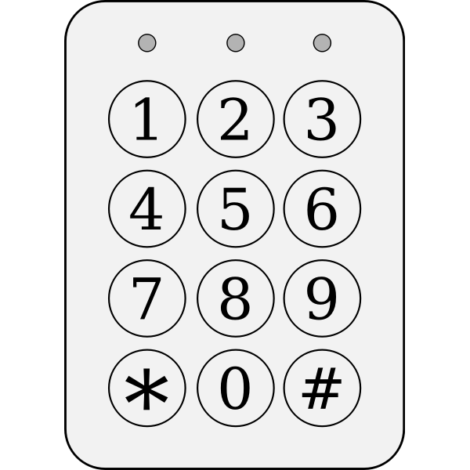
You reach the door. You see the keypad and a riddle.
Enter the next two numbers in the sequence to unlock the door:
90, 85, 75, 60, ___ , ___
Click here for a hint
Click here to try the keypad

Slide 7
90, 85, 75, 60, ___ , ___
The numbers are decreasing in a pattern: first by 5 (from 90 to 85), then by 10 (from 85 to 75), and then by 15 (from 75 to 60).
So, if the next two numbers follow that pattern, the correct answer should be…
Click here for another hint
Click here to try the keypad

Slide 8
Let’s have a closer look:
90, 85, 75, 60, ___ , ___
The numbers are decreasing in a pattern: first by 5 (from 90 to 85), then by 10 (from 85 to 75), and then by 15 (from 75 to 60). So, that means the next number should decrease by 20 (60-20=?).
And, finally, the last number in the sequence will decrease from that by 25!
90, 85, 75, 60, ___ , ___
Click here to try the keypad

Slide 9
90, 85, 75, 60, ___ , ___
Click on a set of numbers to enter into the keypad
50, 35
40, 20
66, 65
30, 10
45, 30
40, 15
75, 90
90, 85
35, 05

Slide 10
That didn’t work! Let’s have a closer look:
90, 85, 75, 60, ___ , ___
The numbers are decreasing in a pattern: first by 5 (from 90 to 85), then by 10 (from 85 to 75), and then by 15 (from 75 to 60). So, that means the next number should decrease by 20 (60-20=40)
And the last number in the sequence will decrease by 25!
90, 85, 75, 60, 40 , ___
Click here to try the keypad

Slide 11

You enter 4-0-1-5 into the key pad. Click. The door opens. Yes!
You turn the handle and find yourself in an empty room. You take a few steps forward and see another door in front of you.
Suddenly, a voice from a speaker startles you: “In order to escape the overnight library, you must solve three riddles. Begin by entering door 1.”
1
Click here to enter door 1
Word Scrambler

Slide 12
Word Scrambler
Rearrange the letters to answer this joke:
What do librarians take when they go fishing?
K
O
W
B
O
R
O
M
Click here for a hint
Click here when you have solved this riddle

Slide 13
People often take an insect to use as bait when they go fishing... and librarians love to read!
Click here to go back to the word scrambler

Slide 14
“Bookworm!” you shout.
“Congratulations,” you hear from the speaker. “Please proceed into the second room.”
2
Click here to enter door 2
Number cipher

Slide 15
Number Cipher
Use the legend below to solve the riddle by matching the numbers in the top row with their corresponding letters in the second row:
1 | 2 | 3 | 4 | 5 | 6 | 7 | 8 | 9 | 10 | 11 | 12 | 13 | 14 | 15 | 16 | 17 | 18 | 19 | 20 | 21 | 22 | 23 | 24 | 25 | 26
A | B | C | D | E | F | G | H | I | J | K | L | M | N | O | P | Q | R | S | T | U | V | W | X | Y | Z
What is Bigfoot’s favourite book?
8 | 1 | 9 | 18 | 25
16 | 15 | 20 | 20 | 5 | 18
Click here when you have solved this riddle

Slide 16
“Hairy Potter!” you shout.
“Congratulations,” you hear again. “Please proceed into the third and final room.”
3
Click here to enter door 3
Reverse Alphabet

Slide 17

Reverse Alphabet
Use the legend to solve the riddle by matching the letters from the top row with their corresponding letters in the second row.
Z | Y | X | V | S | R | O | K | I | G | F | B
What building has the most stories?
A | B | C | E | H | I | L | P | R | T | U | Y
G | S | V
K | F | Y | O | R | X
O | R | Y | I | Z | I | B
Click here when you have solved this riddle

Slide 18

“The Public Library!” you shout excitedly.
Clink! A key drops from the ceiling. You pick it up, insert it into the lock, open the door, and step outside. It’s no longer raining.
“Phew! That was… uh… interesting,” you say to yourself as you dash home.
Clink!
Click here to exit
EXIT!

Slide 19


The End

